Slide 1
Project Report on
T-20 World Cup 2022 Data Analysis
by
Shibasis Karmakar
Internship Program
Under the Guidance of:
Mentorness
Notes:
This template is provided by http://www.free-power-point-templates.com/

Slide 2
DECLARATION
I, Shibasis Karmakar, a working professional , have completed my Graduation from Calcutta University in 2010 on B.com(h). The Project Report on A Study on
T-20 World Cup 2022 Data Analysis from Mentorness is the original work conducted by me.
The information and data given in the report is authentic to the best of my knowledge. This report has not been submitted to any other university for the award of any other degree, diploma and fellowship.
Shibasis Karmakar
Place: West Bengal(Kolkata)
Date of submission: 03/05/2024

Slide 3
Project Title
Data Sources
Tool used
Data Set
Provided by Mentorness
Internship Project
Via Email.
T-20 World cup 2022.CSV
Total Row Total columns
9814 45
Software: Excel, Python, Jupyter Note book
Hardware: AMD Ryzen 3 2200G with Radeon Vega Graphics 3.50 GHz
Ram:8.00 GB.
Edition: Windows 10 pro

Slide 4
Introduction/Brief Description on Dataset
Welcome to the T-20 World Cup 2022 Data Science project. In this endeavor, we'll embark on an exciting journey of comprehensive data analysis, drawing meaningful insights from the action-packed world of T-20 cricket. We'll dive deep into the dataset, explore the nuances of the game, and provide valuable insights and inferences. The T-20 World Cup 2022 dataset provides a goldmine of cricket data, including detailed match statistics, player performances, and game-changing events.
Dataset Overview:
The dataset contains detailed information on T-20 World Cup 2022 matches. It includes:
- Match details: Match ID, names of the home and away teams, innings details, over-by-over progress.
- Player statistics: Runs, wickets, and other player-specific details.
- Match events: Boundaries, wickets, retired hurt scenarios, and more.
- Commentary text: Pre-match, in-match, and post-match commentary snippets.

Slide 5
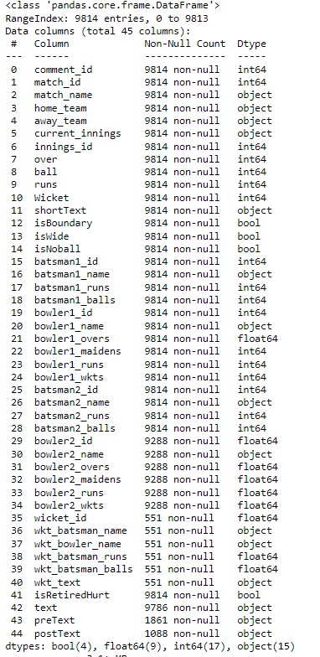
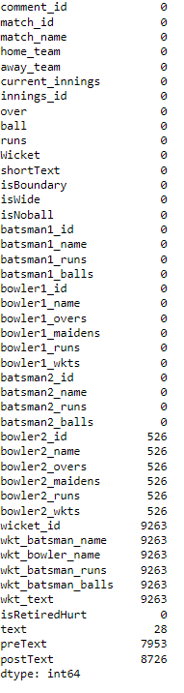

Basic info about the Data set
As per the Data Set we can see the numbers of columns & Rows, which is 9814 rows & 45 columns.
After the sanitary check we found null values & there was
duplicate data found in the given data set.

Slide 6
Teams Participating in the Tournaments
1.INDIA
2.AUSTRALIA
3.ENGLAND
4.PAKISTAN
5.NEW ZELAND
6. SRI LANKA
7. Bangladesh
8. NAMABIA
9. SOUTH AFRICA
10. AFGANISTAN
11. IRELAND
12. SCOTLAND
13. UNITED ARAB EMIRATES
14.WINDIES

Slide 7
LET’S FOCUSED ON TOP 10 TEAM
1.INDIA
2.AUSTRALIA
3.ENGLAND
4.PAKISTAN
5.NEW ZELAND
6. SRI LANKA
7. Bangladesh
9. SOUTH AFRICA
10. AFGANISTAN
14.WINDIES

Slide 8
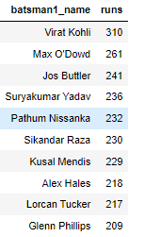
Top 10 Run scorers
As per the data we can see that the top 10 batsman who scores run’s through out the tournament’s.
Out of which below are the top3 contender’s for Best batsman in the tournament’s.
1. Virat Kohli- India.
2. Max O'Dowd – Netherland
3. Jos Buttler – England

Slide 9
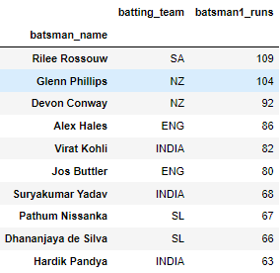
Top 10 Highest Run Score
As per the data we can see that the top 10 batsman who scores Highest individual run’s in a Single match .
Out of which below are the top3 contender’s for the Highest individual run getter in the tournament’s.
1. Rilee Rossouw – South Africa.
2. Glenn Philips – New Zealand.
3. Devon Conway– New Zealand.

Slide 10
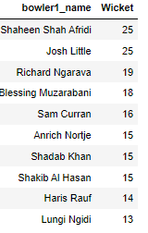
Top 10 Wicket Taker’s
As per the data we can see that the top 10 bowler’s who takes wicket’s through out the tournament’s.
Out of which below are the top3 contender’s for Best bowler in the tournament’s.
1. Shaheen shah Afridi - Pakistan.
2. Josh Little– Ireland.
3. Richard Ngarava– Zimbabwe.

Slide 11
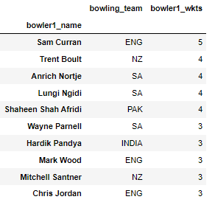
Top 10 Individual Highest Wicket Taker’s
As per the data we can see that the top 10 individual bowler’s who takes highest wicket’s in a single match.
Out of which below are the top3 contender’s for Best bowler in the tournament’s.
1. Sam Curran - England.
2. Trent Boult – New Zealand.
3. Anrich Nortje – South Africa.

Slide 12
Now take a glance of a particular team
T-20 World Cup winner 2022
England

Slide 13
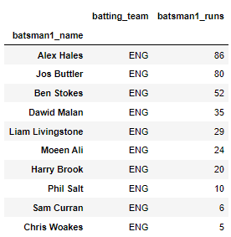
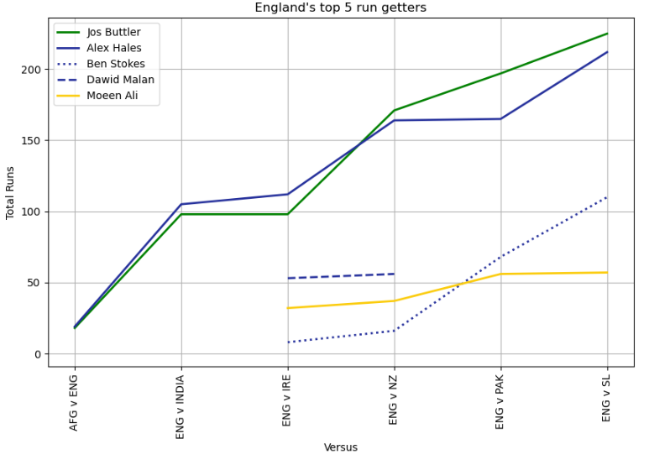
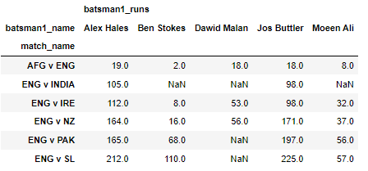
England Top 5 Run getter’s

Slide 14
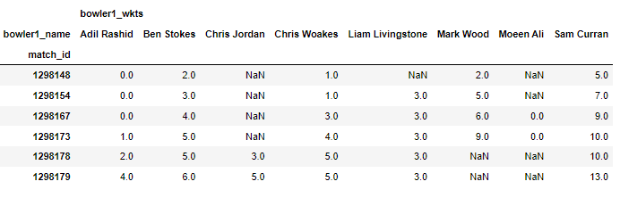
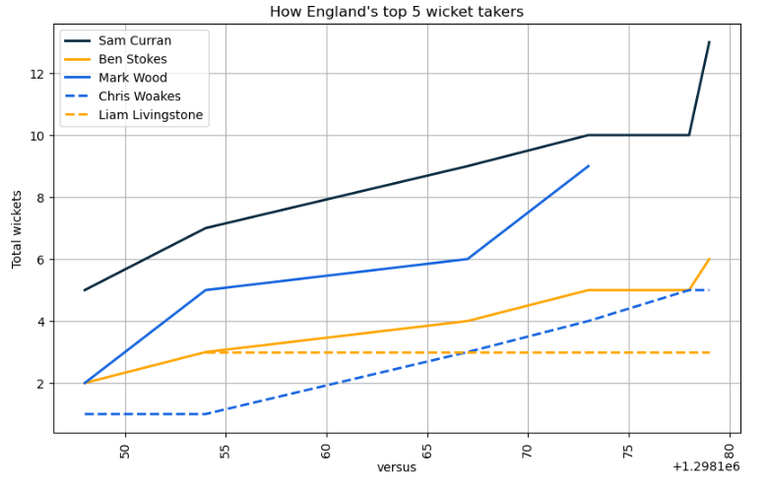
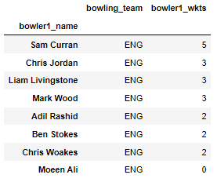
England Top 5 wicket taker’s

Slide 15
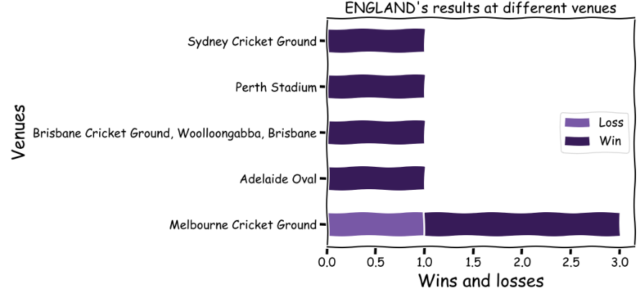
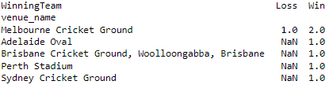
England’s Wining &lossing venue’s
Here We can see that England favorite ground in term’s of Wining is
Melbourne Cricket Ground

Slide 16

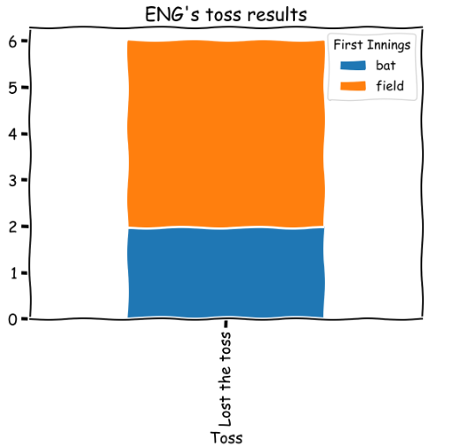
England tossing factor
As per the below data we can see the toss wining plays a vital role for England to win the Matches.
Most of the time England’s won the toss & elected to field first.

Slide 17



Roads to Winning the Title- T20 world Cup
Semi-Final
Final

Slide 18
Thank You

